Slide 1
A PROJECT WORK
ON
DETECTION OF MALARIA PARASITES IN BLOOD SMEARS USING CONVOLUTIONAL NEURAL NETWORKS
OMOREGIE EFE MARVELLOUS
BAS/CSC/160310

Slide 2
Statement of the Problem
Malaria is a life threatening disease so rapid, accurate diagnosis is required to control the disease. The detection of Malaria parasites is done by pathologists manually using microscopes. So, the chances of false detection due to human error still exists, which in turn can result into fatal conditions. The accurate and timely diagnosis of malaria infection is essential to control and cure the disease.

Slide 3
Aim and Objective of the Study
This major aim and objectives of this study include:
Exploring the possibility of computerized diagnosis of malaria.
Implementing a convolutional neural network using supervised machine learning to reliably detect the presence of malaria parasites in images of a patient’s blood sample.

Slide 4
Significance of the Study
It will help to aid medical doctors in rural areas with limited or no access to pathologists.
It can be used in battling malaria outbreaks where hundreds of blood samples may need to be tested quickly and accurately.
It can support academic development in the study of medicine, pathology and microbiology.

Slide 5
Scope of the Project
A set of training sample images used to indicate patterns of malaria infections.
A system for malaria diagnosis meant to serve medical doctors, pathologists and other medical personnel.
A parasite detection algorithm to detects parasites of the plasmodium species only.

Slide 6


Analysis of the Existing System

Slide 7
Limitations of the Existing System
• Lack of resources to provide all laboratories with equipment and good-quality reagents for microscopy.
• Difficulty in maintaining microscopy facilities in good order and lack of microscope maintenance capability.
• Lack of electricity, water and suitable laboratory facilities in some rural areas.
• Heavy workloads, which delay the provision of results to clinical staff.

Slide 8
Justification of the New System
Digitization of Output
Simpler and faster Diagnosis
Reliability
Higher Accuracy
Reduction of costs
Availability
Higher Quality

Slide 9
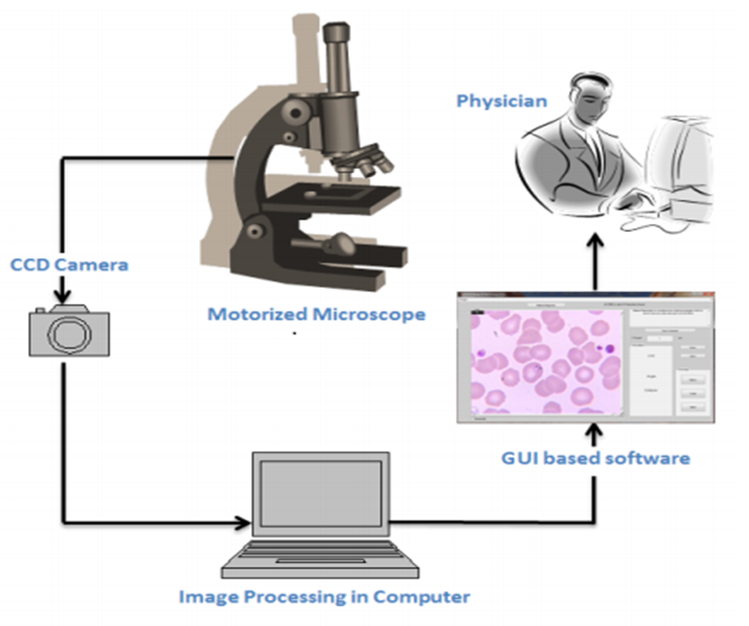
Requirements for the New System

Slide 10
Supervised Machine Learning
Supervised Learning is a machine learning algorithm that involves direct supervision of the learning operation. In this case, the programmer labels training data and sets strict parameters upon which the algorithm operates. It is a spoon-fed version of machine learning: you select what kind of information output (samples) to “feed” the algorithm and what kind of results it is desired (for example “yes/no” or “true/false”). From the machine’s point of view, this process becomes more or less like a game or a “connect the dots” routine.

Slide 11
The Convolutional Neural Network
Convolutional neural networks are deep artificial neural networks that are used primarily to classify images (e.g. name what they see), cluster them by similarity (photo search), and perform object recognition within scenes. They are algorithms that can identify many aspects of visual data. These make the networks more efficient to implement and vastly reduce the amount of parameters to tune which is why it is ideal for this project.

Slide 12
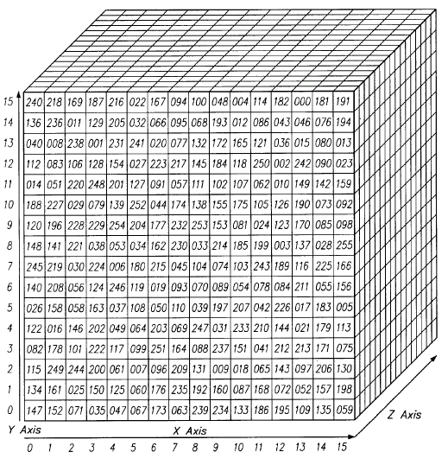
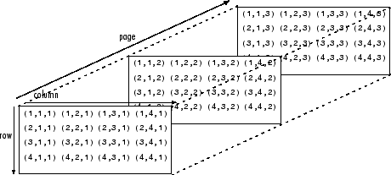
The Three Layers of an Image(Red-Green-Blue)

Slide 13
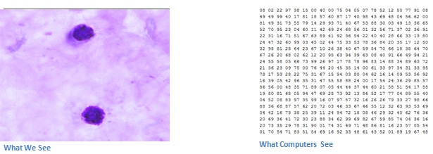
What we see vs What Computers see

Slide 14
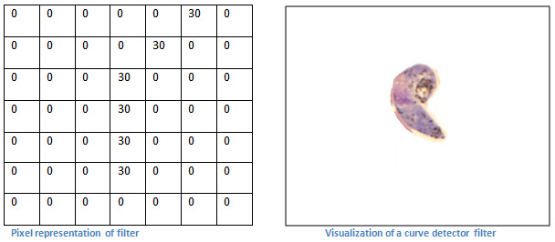
The pixel representation of filters/feature maps

Slide 15
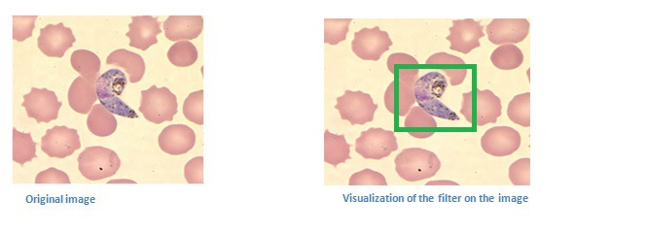
An example of a new blood sample that we want to classify

Slide 16
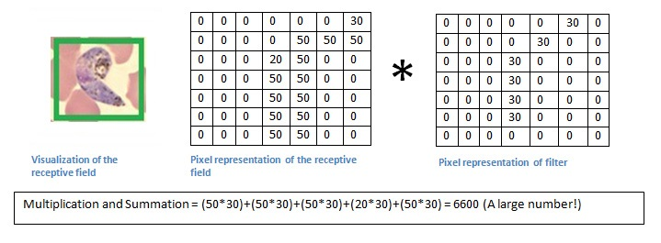
Comparison of the values in the filter with the original pixel values of the image.

Slide 17
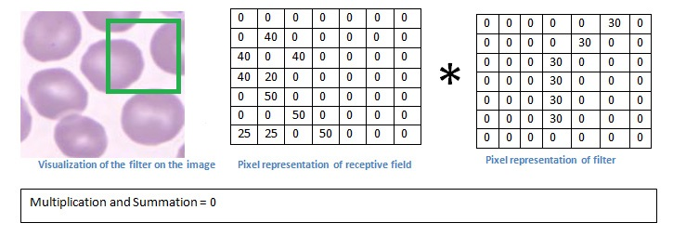
Comparison of the values in the filter with the original pixel values of the image.

Slide 18
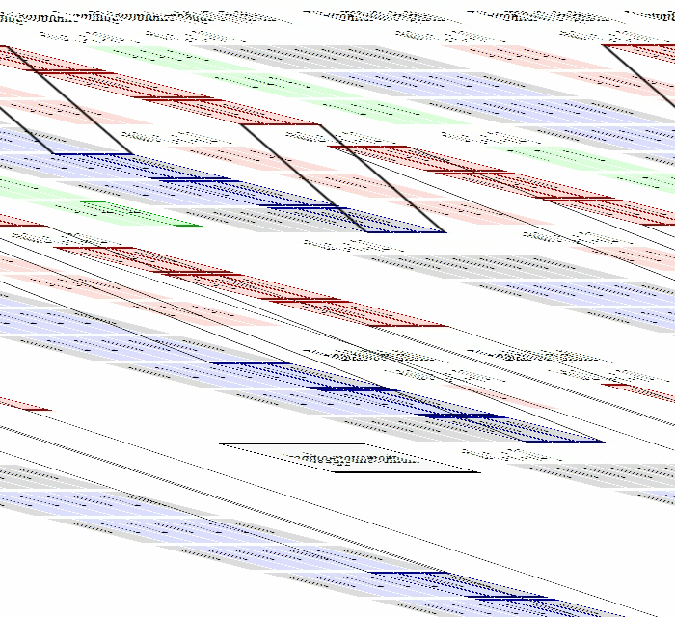
Graphical illustration of the Repeated Convolution

Slide 19
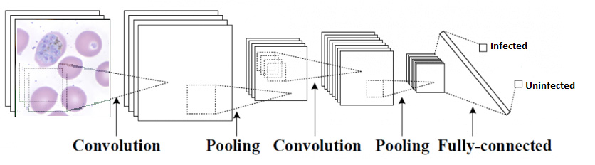
Diagram of the Convolutional Neural Network

Slide 20
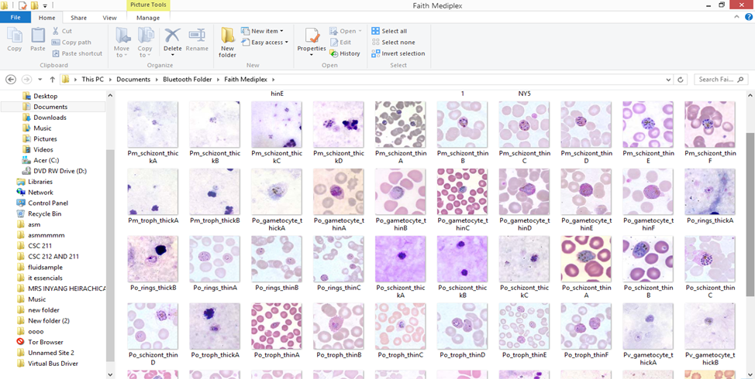
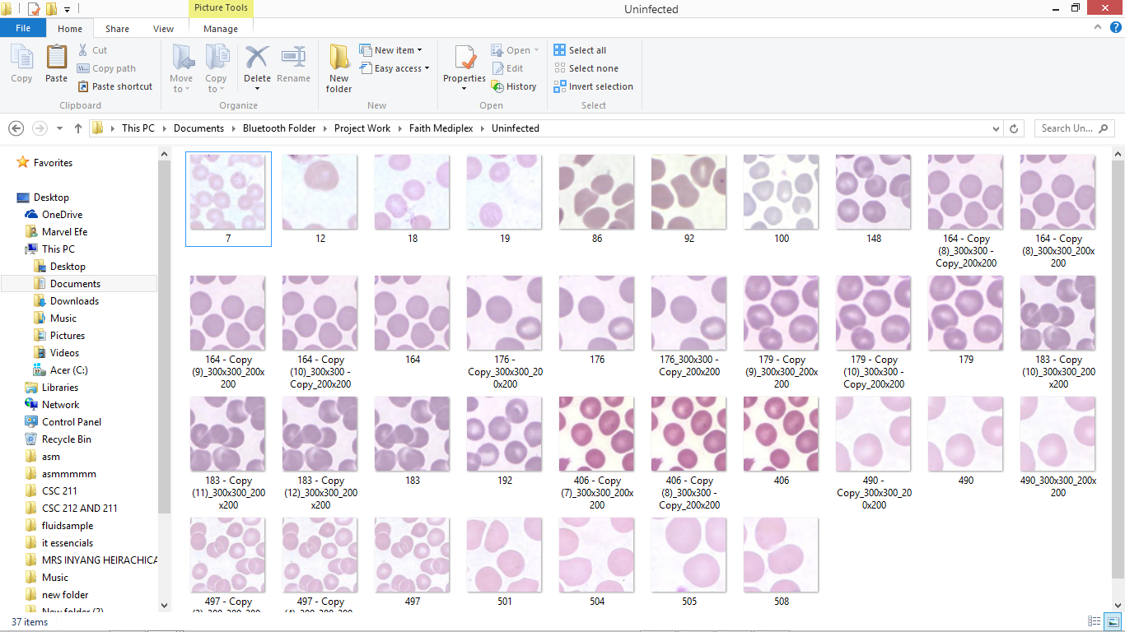
The Training Data for the two classes (infected, uninfected)
Infected
Uninfected

Slide 21
THANK YOU

